Slide 1
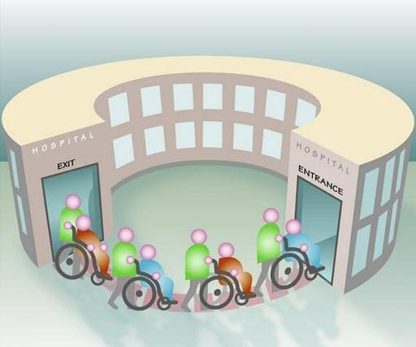
Prediction on Hospital Readmission
Classification using Diabetes Dataset
IST 719 BIG DATA ANALYTICS
PROFESSOR WILLARD E WILLIAMSON
TEAM MEMBERS:
AKHIL NAIR| LAXMAN KUMAR | BHAVISH KUMAR | SAHEB SINGH

Slide 2


PROBLEM STATEMENT
Diabetes is a widespread chronic disease that is accompanied with irregularities of blood glucose levels due to problems related to insulin.
250 millions across 98,000 patients can be saved using predictive modeling.
Patient readmission rates are the indicator of hospital quality and treatment quality. High readmission rate might result in hospital getting penalized.
Identifying the most important factors which lead to patients getting readmitted and able to predict if a patient is going to be readmitted, the treatment provided by the hospital can be changed, to avoid a readmission and improve quality of healthcare while saving millions of dollars.

Slide 3

DATA DESCRIPTION
This data contains whether patient was readmitted for diabetes complications after initially receiving treatment and being discharged from the hospital.
The data also contains information about the patient when he/she was admitted and discharged.
We also have detailed data about the number of procedures performed on the patient along with the total time spend in the hospital before being discharged.
The data also gives detail information about the change in the patient status by giving us information about the change in most important factors such as - Insulin Level, Glucose Serum etc.
We have total 1,01,766 patients(rows) with 35 different features(columns).

Slide 4

DATA PREPROCESSING
Dropped columns with > 50% missing values
Dropped primary & foreign key columns (Eg: Patient ID)
Dropped columns with close to 0 variance
Imputation of missing values with mode
Datatype correction
Univariate Analysis to view distribution and check for outliers
One Hot Encoding

Slide 5

Exploratory and Explanatory Data Analysis

Slide 6

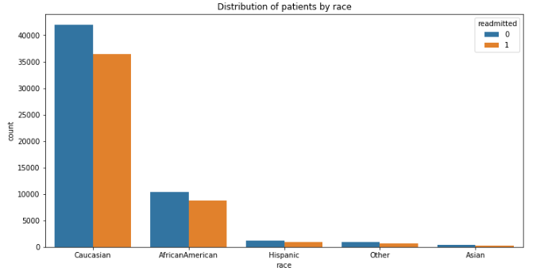
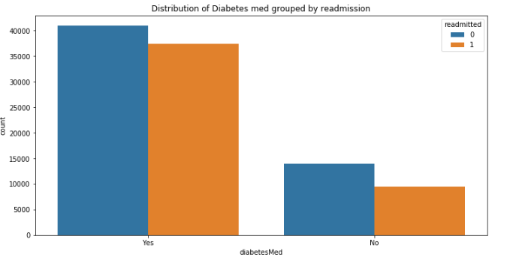
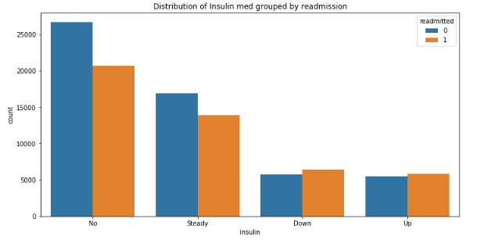
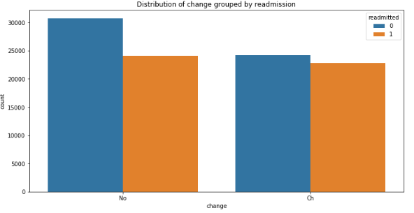
Notes:
Data is balanced w.r.t to readmission with 55% of the data with readmission as true and rest 45% as false
About 77% our data belongs to Caucasian race followed by African American with 18% of the total data. Combining Asian, Hispanic and other we have total 5% of the data
We have approximately equal data of both gender with 53% females and rest male
We have higher number of patient’s data who are on diabetes med than who are not

Slide 7
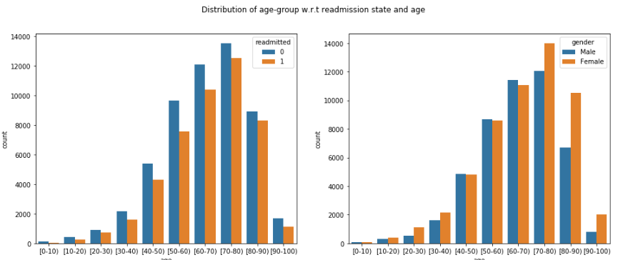

Slide 8
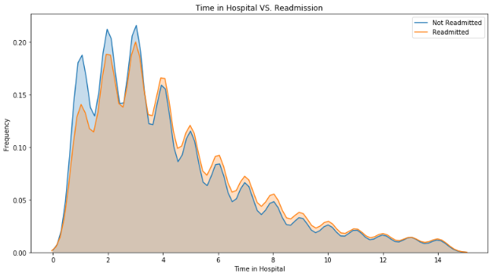
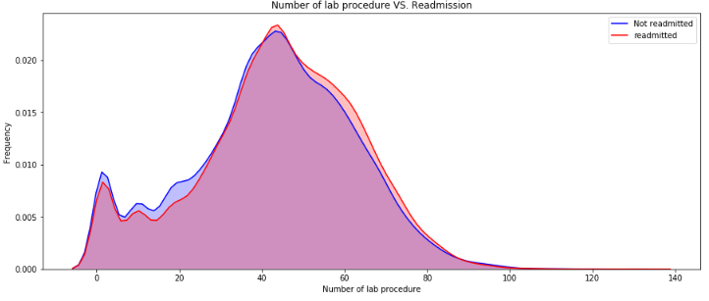

Slide 9
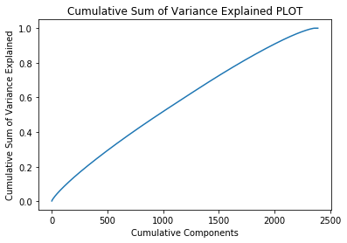
Identifying Feature Importance: Principal Component Analysis
Notes:
Used PC1 & PC2 to identify the top 20 most important features that explain most of the variation in the data
Cumulative Explained Variance Plot:
Around 2000 Principal components explain around 80% of the variation in the data

Slide 10

MODELS BUILT
We built the following binary classification predictive models
Logistic Regression
Decision Tree
Random Forest
Gradient Boosting
Multi Layer Perceptron

Slide 11
LOGISTIC REGRESSION

Slide 12
DECISION TREE

Slide 13
RANDOM FOREST

Slide 14
GRADIENT BOOSTING TREE
BASELINE MODEL
Accuracy | Recall | AUC
63.60% | 49.26% | 68.82%
Hyperparameters Grid Search & 3-fold Cross Validation
featureSubsetStrategy | stepSize | maxDepth | maxIter
‘auto’ | 0.1 | 5 | 150
TUNED MODEL
Accuracy | Recall | AUC
64.00% | 51.57% | 69.33%

Slide 15
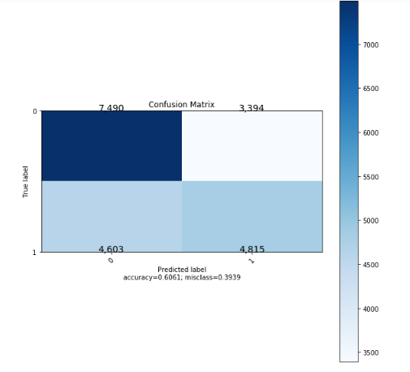
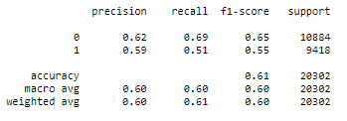
Linear SVM
Hyperparameters
maxIter – 1500
regParam – 0.01

Slide 16
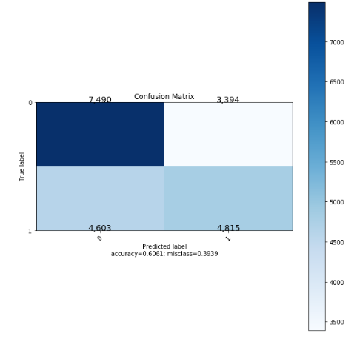
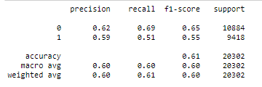
MULTI LAYER PERCEPTRON
One hidden layer with 256 neurons
Block size 64
stepSize 0.05

Slide 17
MODEL PERFORMANCE COMPARISON
ALGORITHM | ACCURACY | RECALL | AUC
Logistic Regression
Decision Tree
Random Forest
Gradient Boosting Tree
Multi Layer Perceptron

Slide 18

PROBLEMS FACED
Large size of the data resulting in high code runtime
Large number of categories in three columns resulting in high dimensional sparse matrix dataset after one hot encoding
Dimensionality Reduction/Feature selection is difficult because of the sparse nature of data with 2000 principal components explaining only ~ 80% variation in the data
Computation resources restriction
Building a Multilayer perceptron model require higher resources. To run a model in current available resources, we have to decrease the train set to 40%

Slide 19


PROJECT TASK DISTRIBUTION
Data Pre-processing
Exploratory Data Analysis
Model Building
Reports & Presentation
All members have equal contribution for presentation and report
Akhil - Logistic Regression, Decision Tree and Random Forest
Bhavish - PCA, Gradient Boosting
This section is completed by Laxman Kumar and Saheb Singh
All members have done some part of pre-processing
Presentation visualization and editing done by Laxman Kumar
Laxman – Linear SVM and Multilayer Perceptron
Saheb – Naïve Bayes

Slide 20


